Slide 1
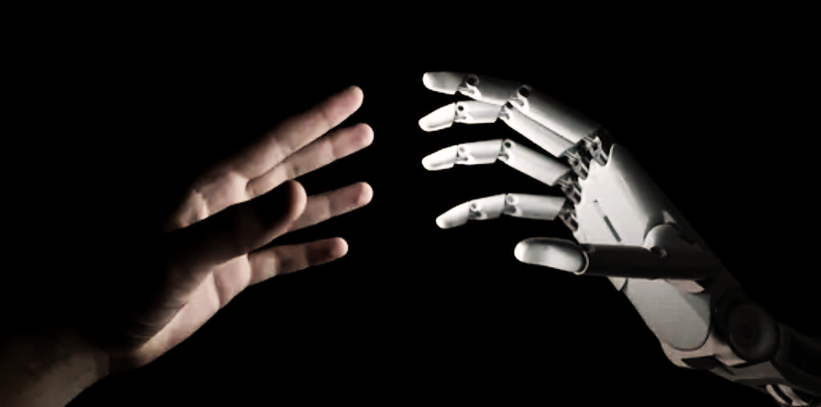
Gesture Control System
20XX
For using Power Point

Slide 2
CONTENT
20XX
1-Introduction to Gesture Recognition
2- Prerequisites
3- What are Gestures
4-Types of Gesture
5- Applications and Importance
6-Technologies Behind Gesture Recognition
7-Implementation in PowerPoint
8-Challenges and Limitations
9-Future Developments
10-Conclusion

Slide 3
Team Introduction
20XX
Project Coordinator
- Sonia Deshmukh
Team Members-
-Prashant Kumar Mishra
-Prakhar Mishra
-Rakesh Kumar
College & Branch
- KIET Group of Institutions(CSIT)

Slide 4
INTRODUCTION
In This project we have created a Hand Gesture based Presentation System, By using this we will be able to control our PPT without actually using the laptop/ Computer.
Gesture control technology represents a paradigm shift in human-computer interaction, offering a more intuitive and engaging means of navigating digital content. The integration of gesture recognition systems within PowerPoint introduces a new dimension to presentations, transforming the way we deliver and engage with information.
Gesture control involves harnessing hand movements or body postures to communicate commands to devices or systems. Focusing particularly on hand gestures, we'll explore their role in controlling the flow, content, and interactivity of PowerPoint presentations.

Slide 5
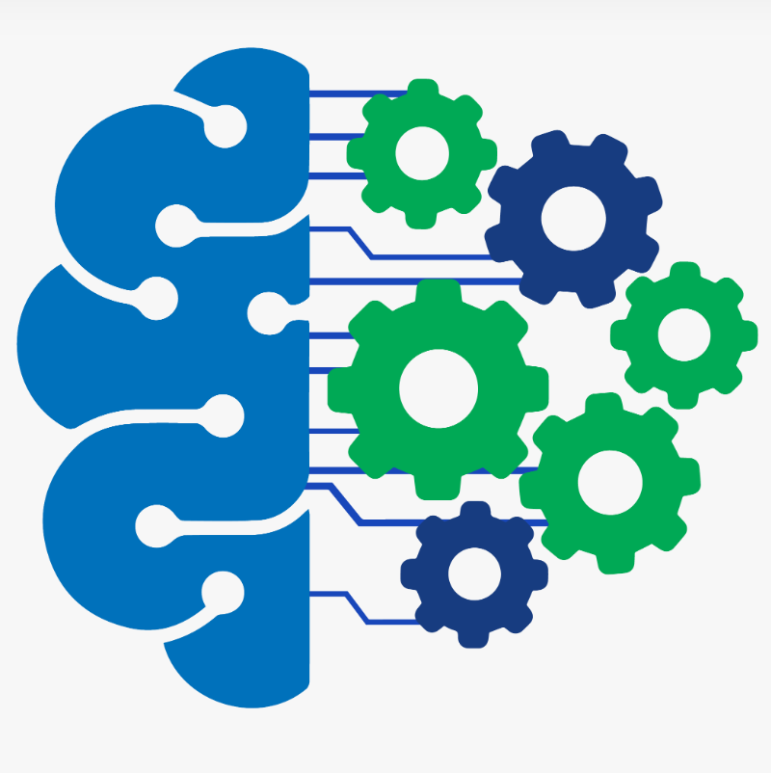




Prerequisites
Knowledge Of AI/ML
Python Language
All About OpenCV
MediaPipe And Other Module Package
Knowledge of version of Python

Slide 6
What are Gestures
Gestures are non-verbal, physical movements or expressions made intentionally or unconsciously using various parts of the body, primarily the hands, arms, face, and body. These movements convey specific meanings, emotions, or messages in communication and can be used alongside or in place of verbal language.
Gestures play a crucial role in human communication, enhancing the clarity of spoken language, emphasizing messages, and conveying emotions. They can also serve as a form of communication in situations where verbal language may not be feasible, such as in noisy environments or when interacting with individuals who speak different languages.
Understanding gestures within a cultural context is essential, as interpretations can vary widely across different cultures and regions. Overall, gestures complement verbal communication, adding depth and nuance to interpersonal interactions.

Slide 7
Types of Gesture
Hand Gestures: Movements or positions of the hands and fingers used to emphasize speech, communicate ideas, or express emotions. Examples include waving, pointing, thumbs up, or the peace sign.
Facial Gestures: Expressions made using facial muscles, such as raising eyebrows, smiling, frowning, or winking, conveying emotions and intentions.
Body Gestures: Postures or movements of the body, excluding the face and hands, used to communicate or express feelings, such as shrugging shoulders, crossing arms, or leaning in.
Emotional Gestures: Gestures that directly express emotions, such as clenching fists in anger, covering the mouth in shock, or hugging as a sign of affection.

Slide 8
Applications:
Gaming: In the gaming industry, gesture control enables players to interact with games using body movements, providing immersive and interactive gaming experiences, as seen in motion-sensing gaming consoles like Xbox Kinect or PlayStation Move.
Healthcare: Gesture control is used in healthcare for touchless interfaces in operating rooms, enabling surgeons to access digital information without contaminating their hands.
Automotive Industry: Gesture control technology is integrated into some automobiles, allowing drivers to perform tasks like adjusting controls, changing music, or answering calls with hand gestures, reducing distraction while driving.
Presentations and Public Speaking: In presentations, gesture control systems aid presenters by enabling them to navigate slides or interact with content seamlessly, adding dynamism to presentations.

Slide 9
Importance
Enhanced User Experience: Intuitive and user-friendly interfaces.
Accessibility: Alternative interface for individuals with disabilities.
Efficiency and Convenience: Streamlined tasks and quicker actions.
Innovation and Future Technology: Evolution in human-computer interaction.
Engagement and Entertainment: Added immersion and enjoyment in various applications.

Slide 10
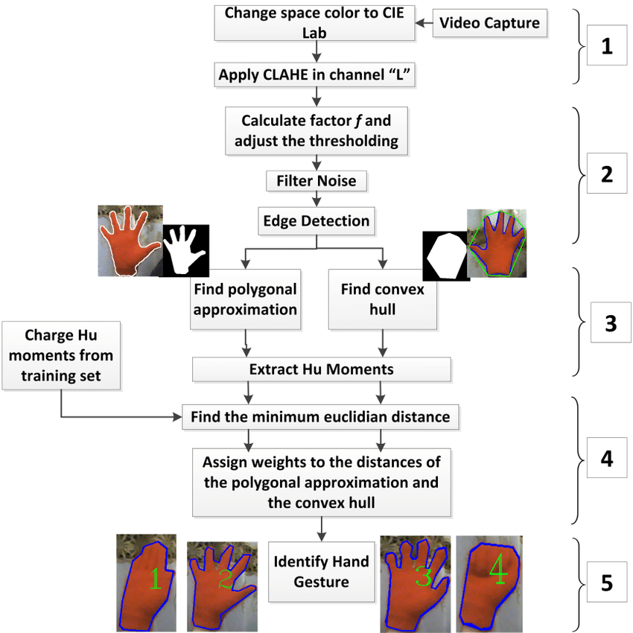
How it works

Slide 11
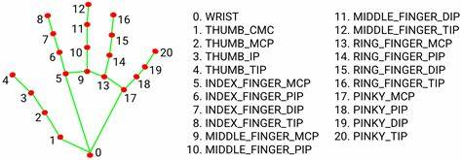
Hand Landmark model of Mediapipe

Slide 12
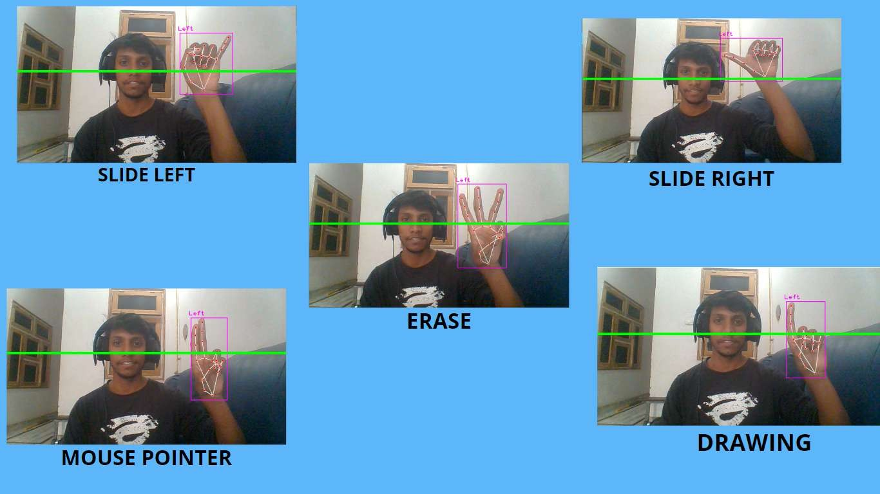
Functions Provided

Slide 13
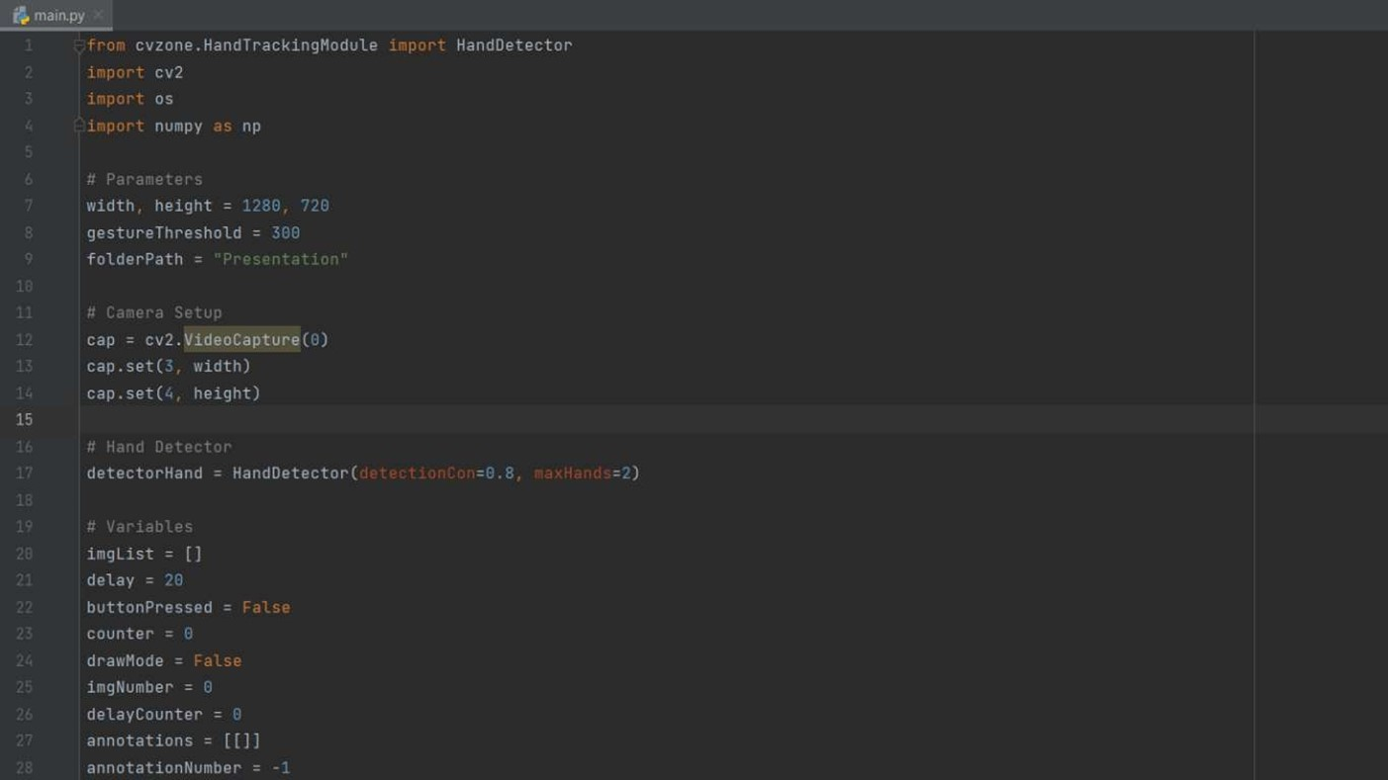
CODE USED
20XX

Slide 14
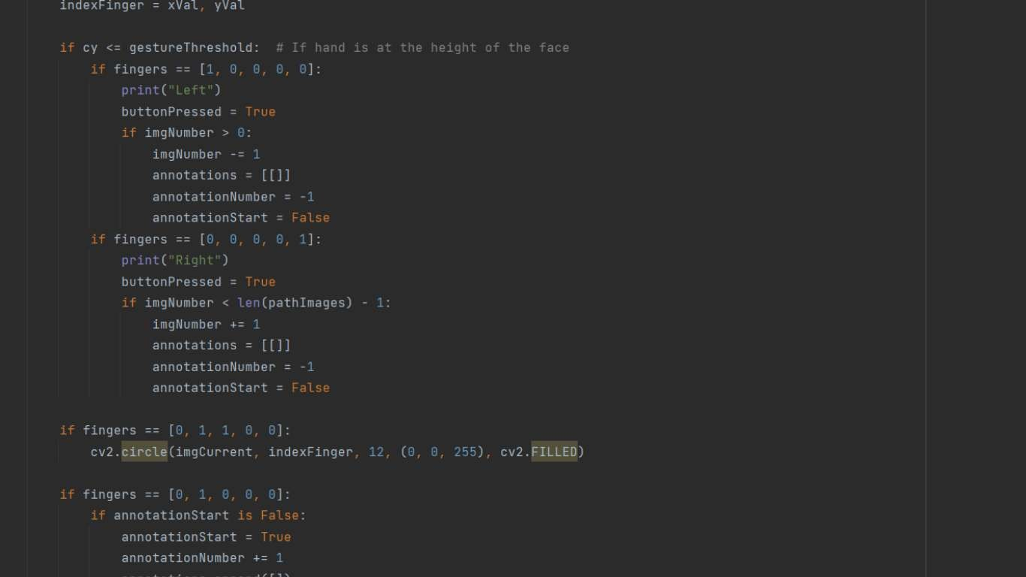

Slide 15
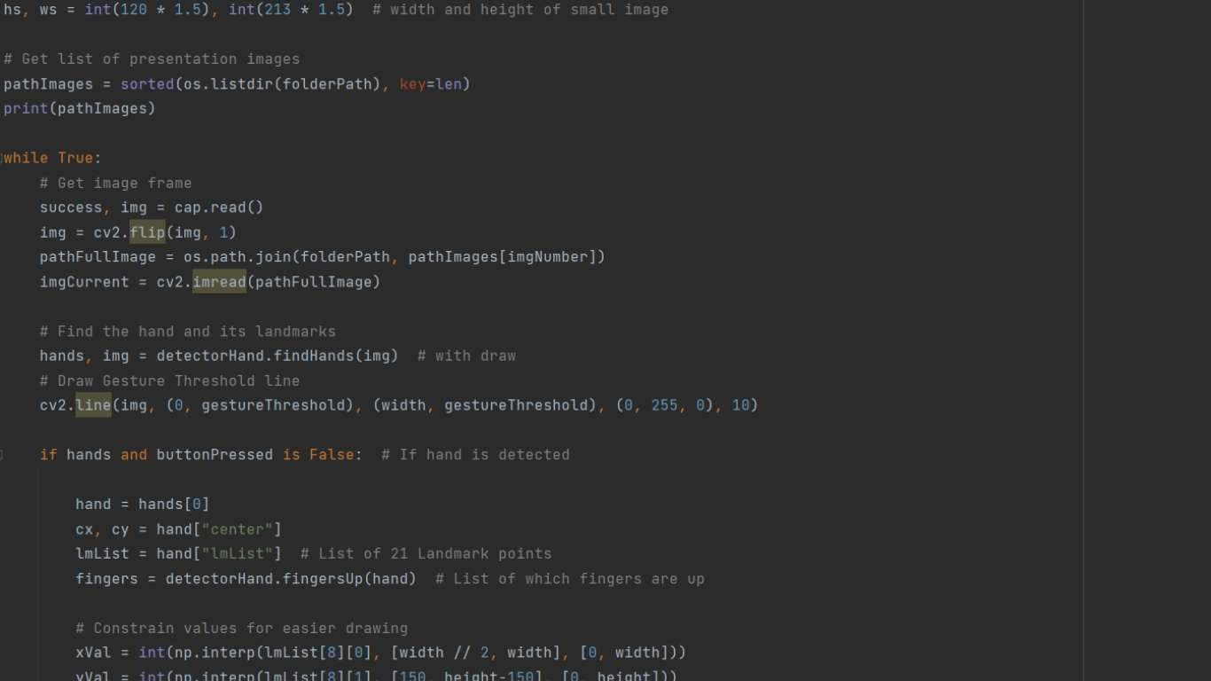

Slide 16
CHALLENGES
Accuracy and Precision
Environmental Variability
Gesture Complexity
Real-Time Responsiveness
Adaptability and Customization
Standardization and Consistency
User Learning Curve
Privacy and Security
Hardware and Technology Limitations

Slide 17
FUTURE DEVELOPMENTS
Enhanced Gesture Recognition Accuracy
Integration of AI and NLP
Expanded Gesture Vocabulary
Wider Hardware Support
Incorporation of VR and AR
Gesture Control Standardization
Accessibility and Inclusivity Focus
Security and Privacy Measures

Slide 18
CONCLUSION
Gesture control technology's significance extends far beyond mere convenience. Its impact resonates in diverse domains, from enhancing accessibility for individuals with disabilities to revolutionizing gaming experiences and transforming how we deliver presentations.
As we conclude this exploration, it's evident that gesture control is not merely a technological advancement but a gateway to a more immersive, accessible, and engaging interaction between humans and technology. The seamless integration of gesture recognition into PowerPoint control signifies the evolution of presentation dynamics, enabling presenters to captivate audiences with fluid, dynamic, and interactive content delivery.
Thank you for joining us on this exploration into gesture control systems for PowerPoint and the limitless potential they bring to redefine how we engage with presentations and technology.

Slide 19

Thank You !
20XX

